Slide 1
PYGP
By: PTE Chen Kay Den

Slide 2
Overview
Base Game
Task
Rubrics
PyGP

Slide 3
Overview
Base Game
Task
Rubrics
PyGP

Slide 4
PyGP Overview:
Test Python proficiency, with emphasis on functions, OOP and CPM
You will be required add new features and improvements to a game
You should utilise functions and OOP
Do collaborate with your teammates using Git
Present your game to the unit

Slide 5
Overview
Base Game
Task
Rubrics
PyGP

Slide 6
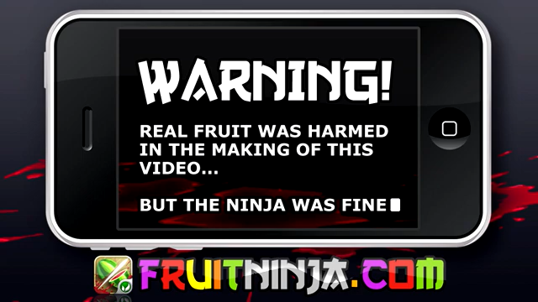

Slide 7
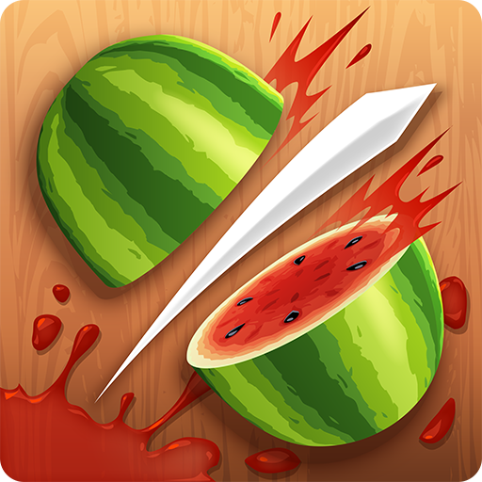
Fruit Ninja
Fruit Nina is a classic mobile game
Players slice fruits that are thrown into their screen whilst avoiding bombs
Goal of the game is to slice as many fruits before time is over

Slide 8
Overview
Base Game
Task
Rubrics
PyGP

Slide 9
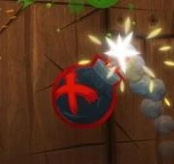
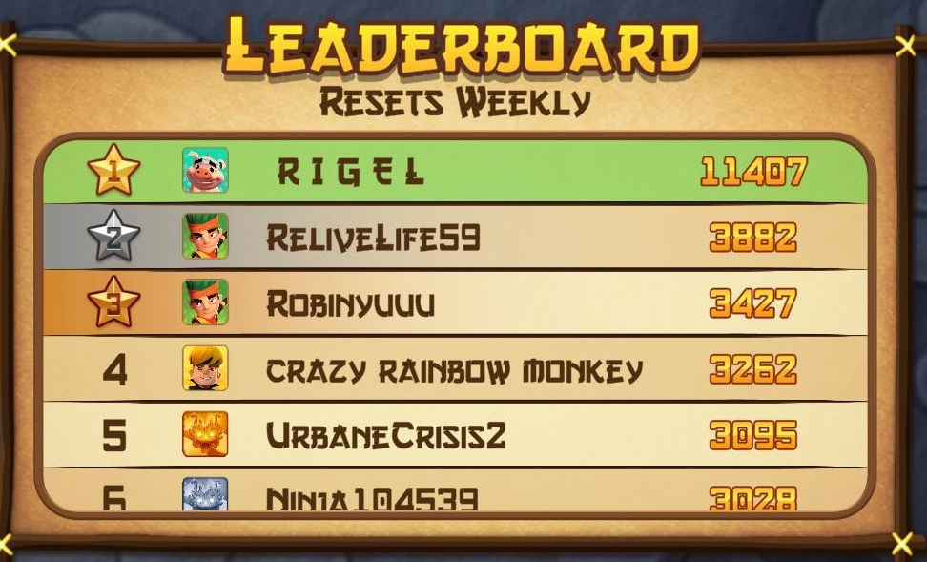
Task
You are provided with a base fruit ninja game
Your Task is to add at least 3 new Features to the game
You must utilize functions and obb
Bomb

Slide 10
Task: Features
Additional Features
Different gamemodes
Leaderboard
Bombs
Combos
Player skins
*This list is non exhaustive. If you have othe suggestions, do ask your master trainer for approval

Slide 11
Overview
Base Game
Task
Rubrics
PyGP

Slide 12
Rubrics
Requirements
Function /OOP based coding
Implement new features
Slides for presentation

Slide 13
Rubrics
Presentation requirements
Black background
Formal presentation (Eloquent and Audible)
Use of flowcharts and images
Using bolded/highlighted text for important information
Inclusion of workload spread
Readable text
Modest use of bullet points
Limit the alternating of speakers
Live showcase of gameplay

Slide 14
QnA

